Slide 1




A DATA-DRIVEN ANALYSIS OF ROAD ACCIDENTS IN THE UK
By Ebrahim Fathalla

Slide 2

INTRODUCTION
Road accidents happen a lot in the UK. They cause injuries, deaths, and cost money. We want to find out why they happen and how to stop them.
01

Slide 3
PROBLEM STATEMENT
Every day, road traffic accidents affect the lives of people across the UK. These incidents result in injuries, loss of life, and significant economic and emotional costs. Despite ongoing efforts, accident rates remain a major public safety concern, especially in urban areas where traffic is dense and road conditions are more complex.
02

Slide 4
OBJECTIVES
To identify patterns and trends in road traffic accidents in the UK.
To determine key factors contributing to accident severity.
To visualize accident characteristics for better public and institutional understanding.
To support decision-makers with data-driven insights aimed at reducing road-related incidents.
03

Slide 5
TARGET AUDIENCE
Transportation planners.
Public safety officials.
Government decision-makers who are responsible for road safety policies and infrastructure planning in the UK.
Law Enforcement Agencies.
Public Health and Safety Researchers.
04

Slide 6





DATA OVERVIEW
Total accidents: 198K
Number of vehicals: 308K
The data comes from UK and is from the year 2021-2022
The data comes from UK Department for Transport
Max speed
Min speed
05

Slide 7

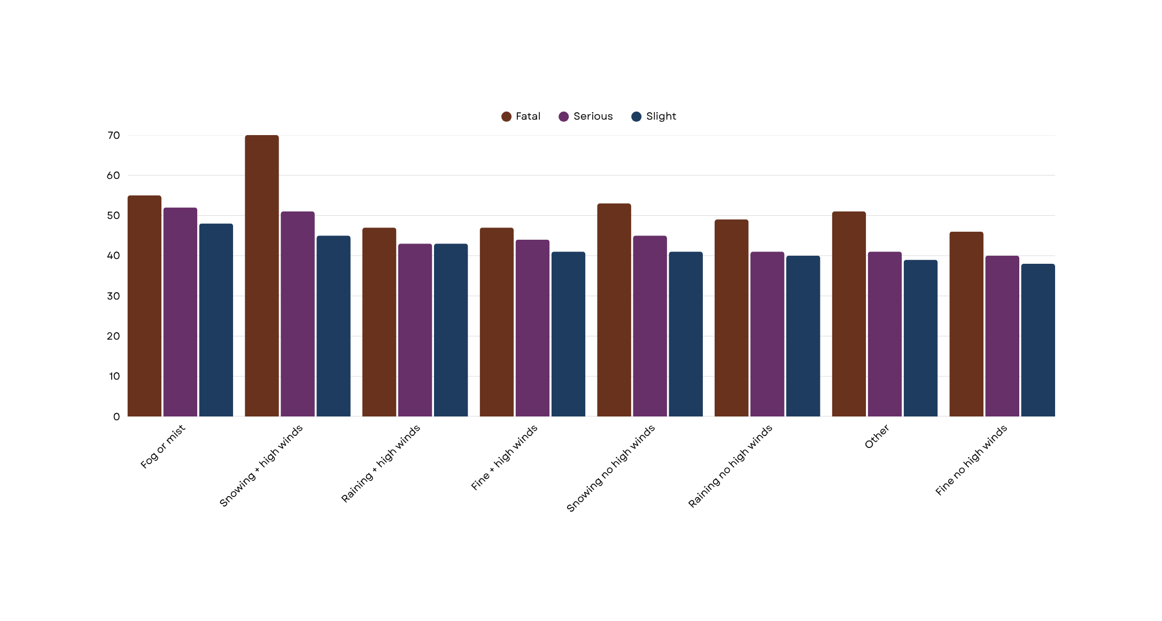
IMPACT OF WEATHER ON ACCIDENT TIMING AND AVERAGE SPEED
06

Slide 8
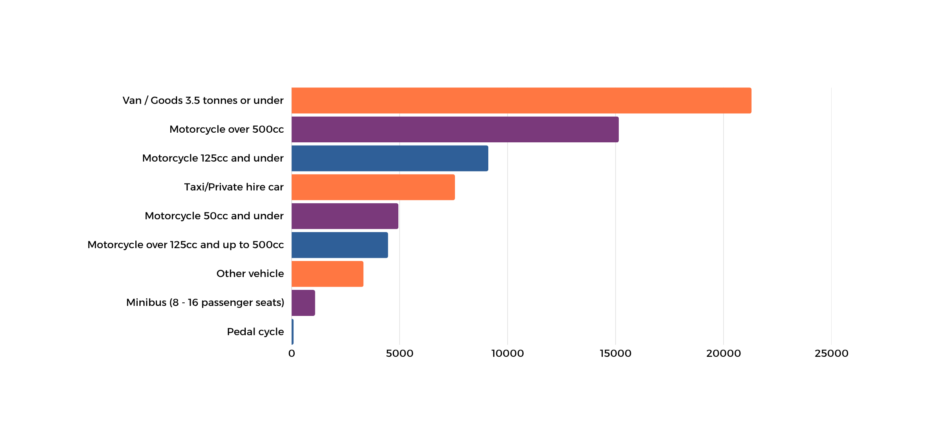
TOP 9 VEHICLE TYPE IMPACT ON CASUALTIES
07

Slide 9
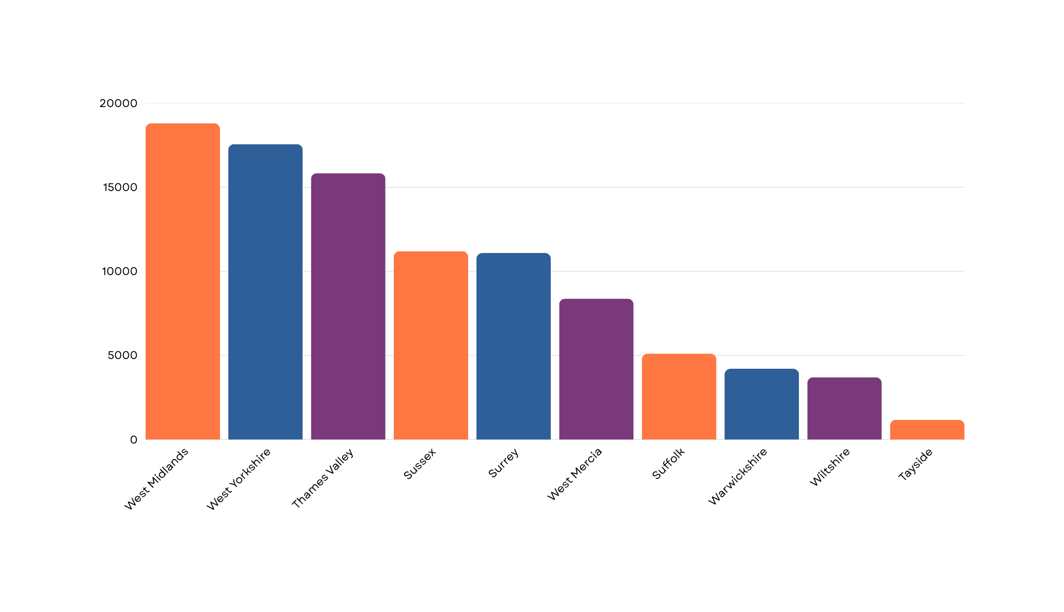
TOP 10 POLICE FORCES WITH MOST CASUALTIES
08

Slide 10
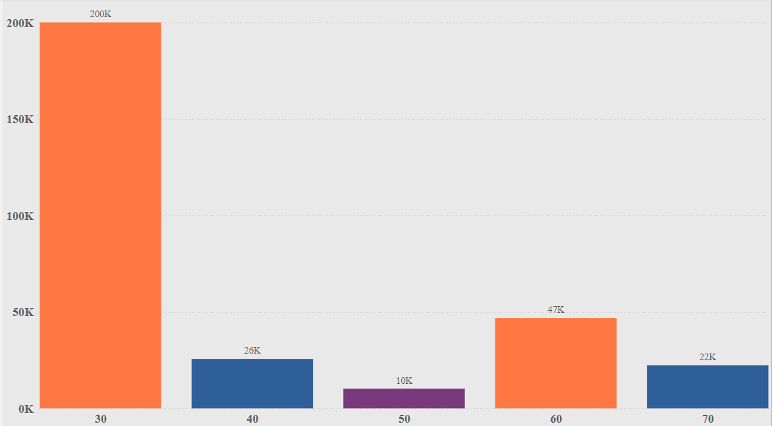
TOP 5 ACCIDENT BY SPEED LIMIT
09

Slide 11
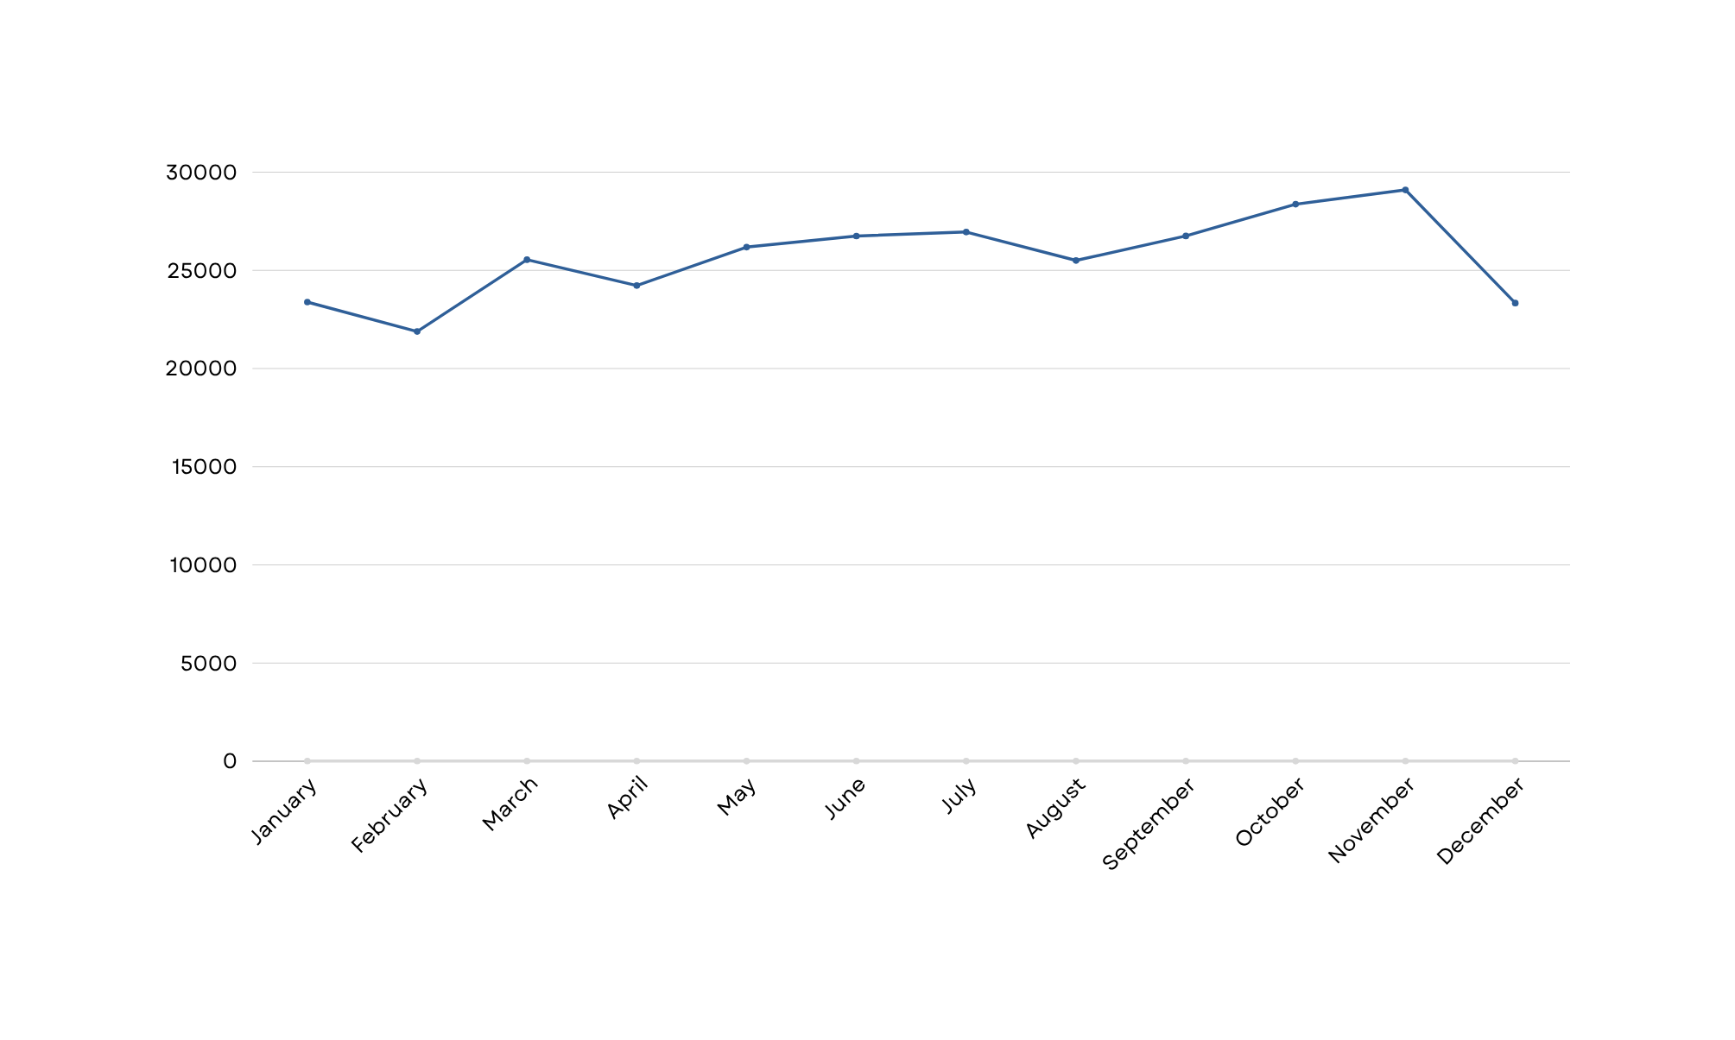
MONTHLY ACCIDENT SEVERITY
10

Slide 12
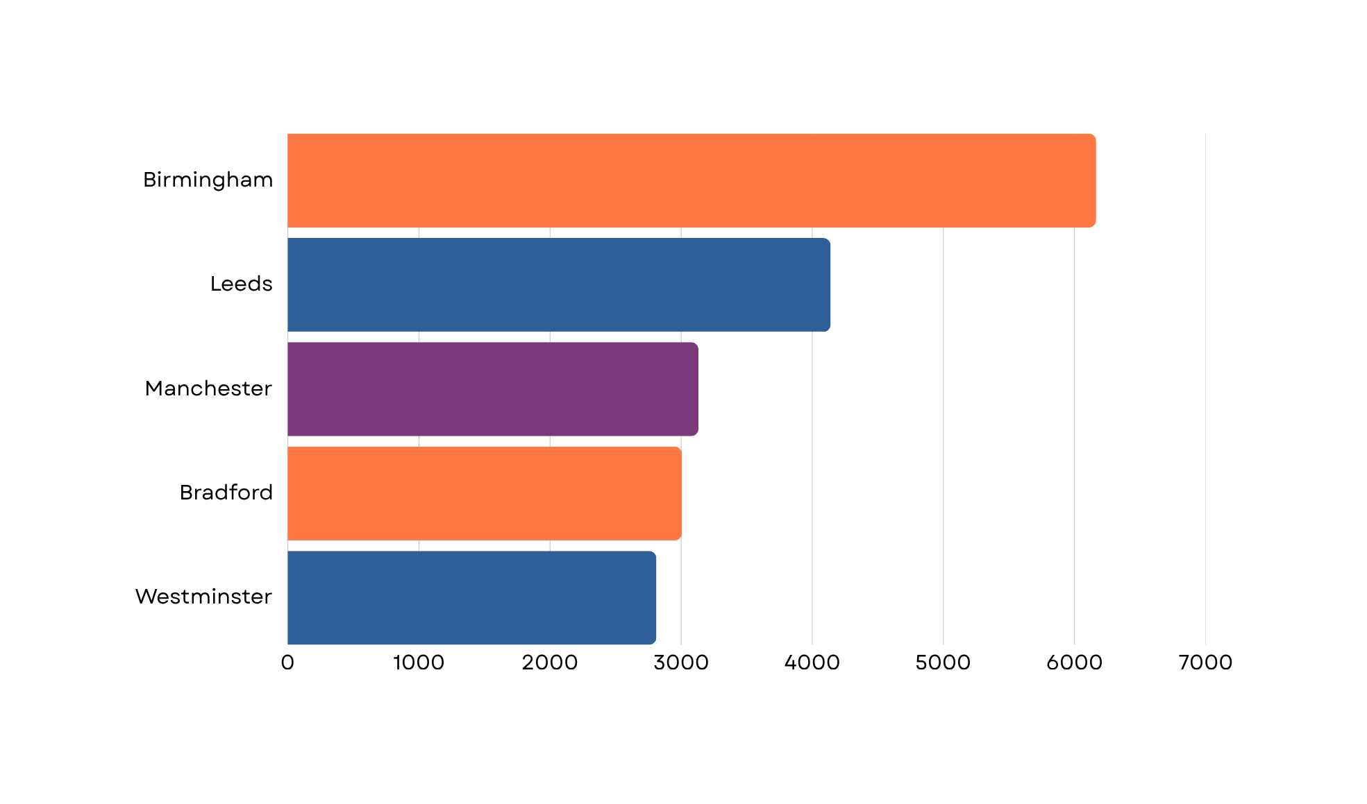
TOP 5 ACCIDENT LOCATIONS
11

Slide 13
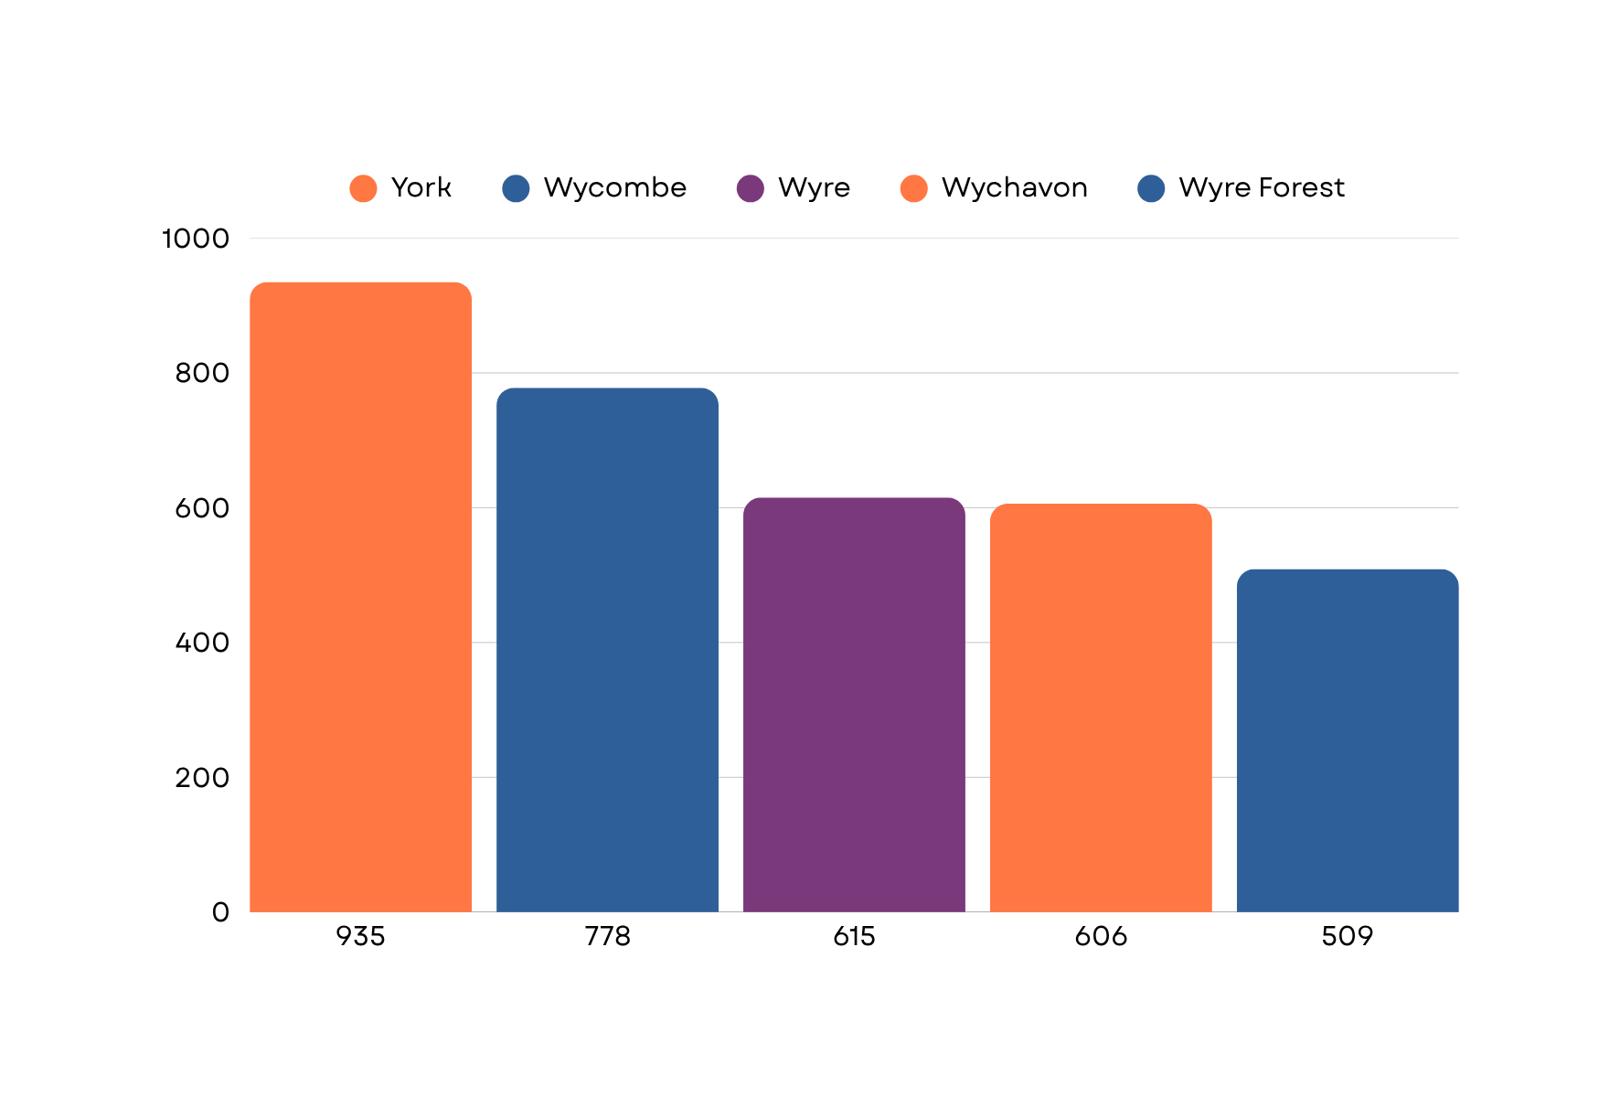
TOP 5 AREAS WITH POOR LIGHTING QUALITY
12

Slide 14
RECOMMENDATION
Implement stricter speed regulations on roads and high-risk zones.
Invest in infrastructure such as road lighting and warning systems in adverse weather-prone areas.
Educate drivers on the risks of driving during peak congestion and in dangerous conditions.
Add more or better lighting where areas have poor lighting.
13

Slide 15
CONCLUSION
In conclusion, this analysis shows that speed, weather, vehicle type, location, and lighting all affect road accident patterns in the UK. By understanding these trends, we can help improve safety through better planning, awareness, and targeted actions.
14

Slide 16
THANK YOU

